Slide 1




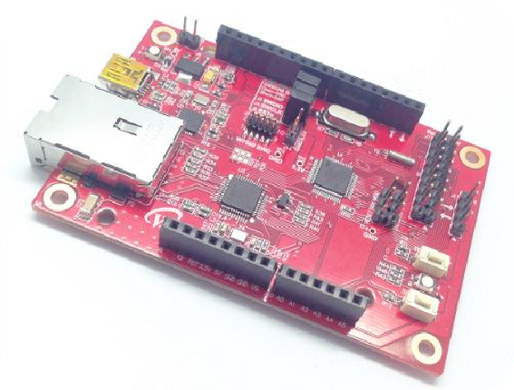


Start IoT Device development with WIZwiki-W7500
- First round -

Slide 2
1. W7500 features
Index
Unattackable Hardwire TCP/IP Chip
IoT optimized MCU
ARM mbed Enabled MCU
Do you dream of Start-up? - VAR products
2. mbed development environment construction
The first step for IoT episode 1 – What is the Web Server ?!
Let’s develop the IoT Device!
Control the Digital Sensor with Web page
Receive Network Information with Web page
Receive Analog Sensor value with Web page

Slide 3
W7500 features

Slide 4
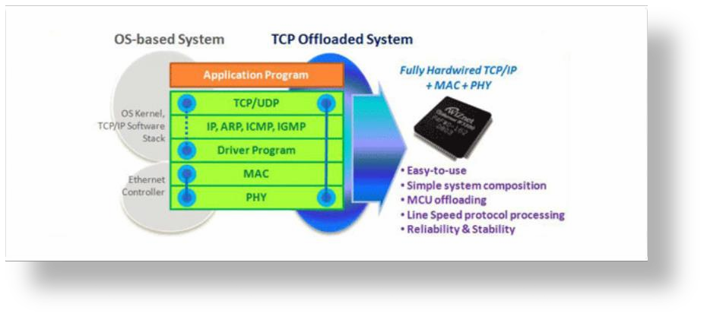
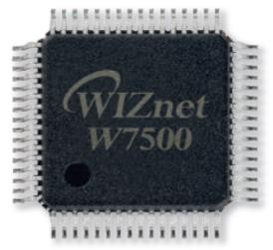

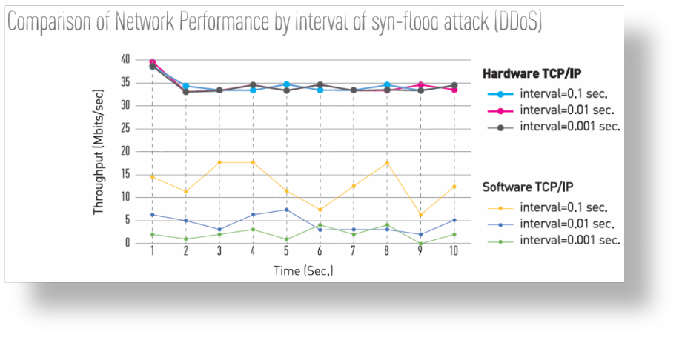

Unattackable Hardwire TCP/IP Chip

Slide 5



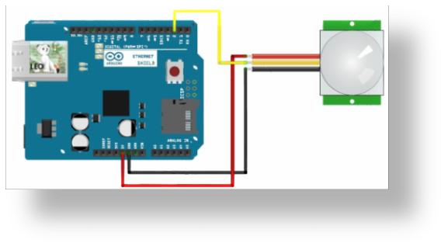



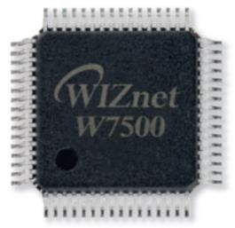


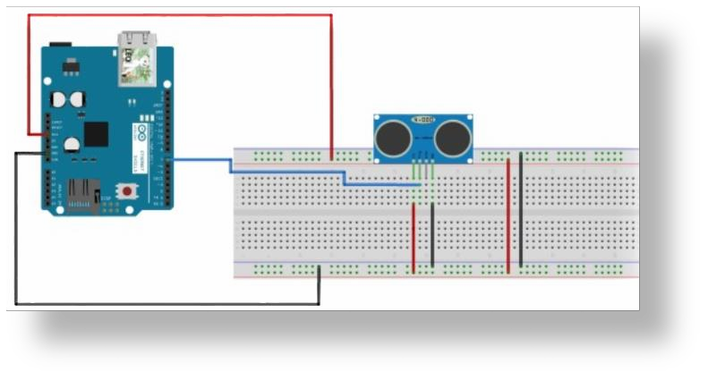


IoT optimized MCU
http://wiznetmuseum.com/application/
http://blog.naver.com/maker_leo/220105028576

Slide 6
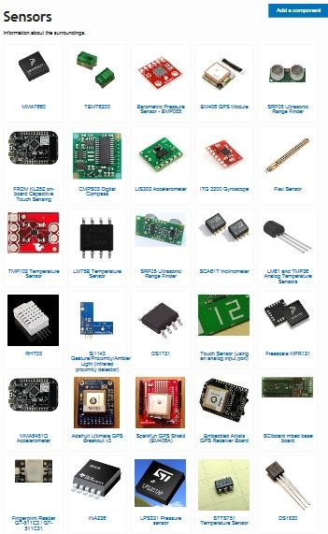
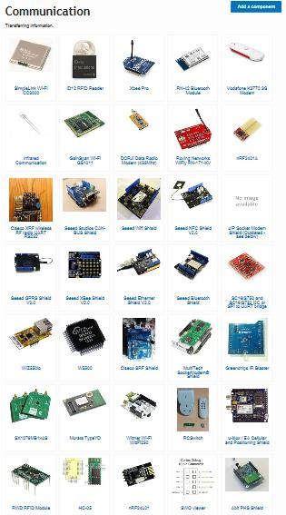
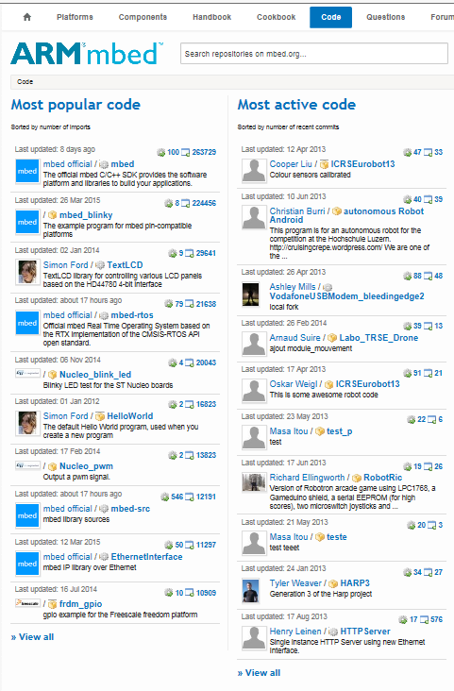
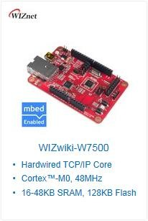

ARM mbed Enabled MCU

Slide 7
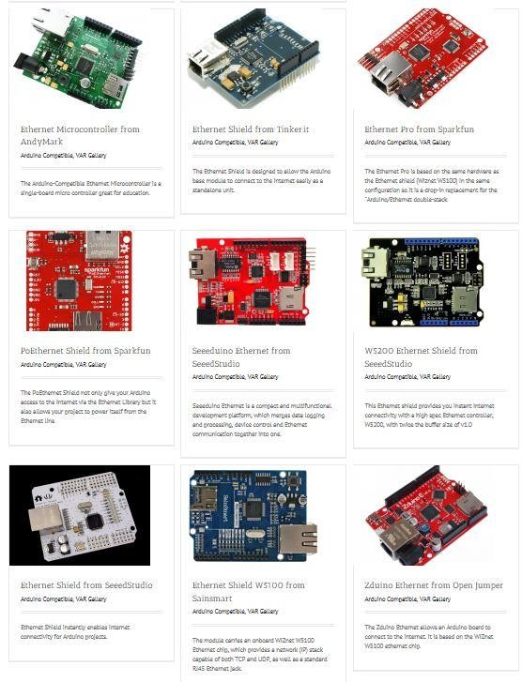
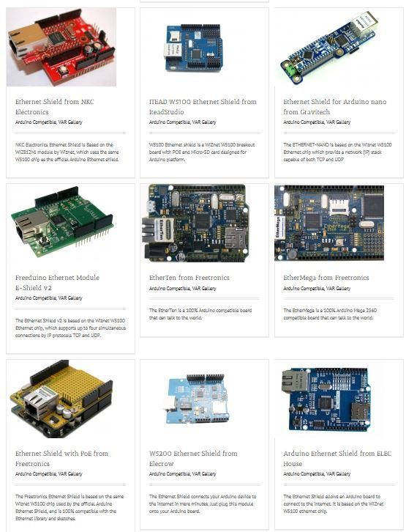
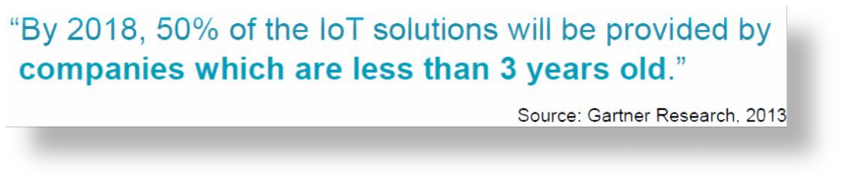


Do you dream of Start-up? - VAR products

Slide 8
About W7500 & WIZwiki-W7500

Slide 9
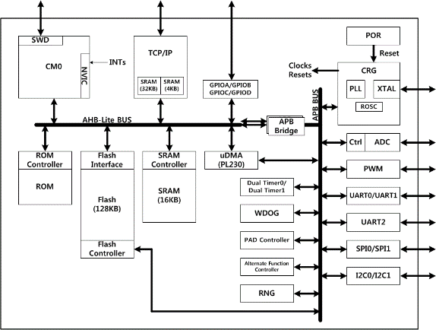
W7500 Feature
http://wizwiki.net/wiki/doku.php?id=products:w7500:start
32-bit ARM Cortex-M0
Flash : 128KB / SRAM : 16KB (up to 48KB)
Hardwired TCP/IP Core (Supports MII Interface)
Internal 8MHz Oscillator
External crystal Oscillator (8~24MHz)
48MHz maximum frequency
PLL for internal clock source
ADC - 12bit, 8ch, 1Mbps
GPIO 53ea I/O
4 Timer/ 8 PWM
3 UART, 2 SPI, 2 I2C
32bit RNG
Serial Wire Debug(SWD)
Package : 64TQFP (7x7 mm)
W7500 System diagram

Slide 10
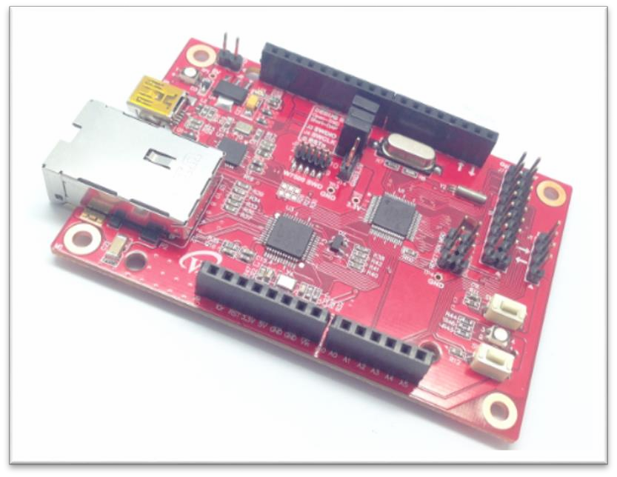

WIZwiki-W7500 Feature
WIZnet W7500
32-bit ARM Cortex-M0
Hardwired TCP/IP Core
Ethernet PHY
IC+ IP101GA
CMSIS-DAP support
NXP LPC11U35FHI33/501
USB Drag & Drop Programming
CMSIS-DAP Debugger
Support IDE : KEIL / GCC
Arduino pin compatible (Arduino Shield is available)
mbed enabled MCU
ISP, SD Card, RGB LED, SWD Connector

Slide 11
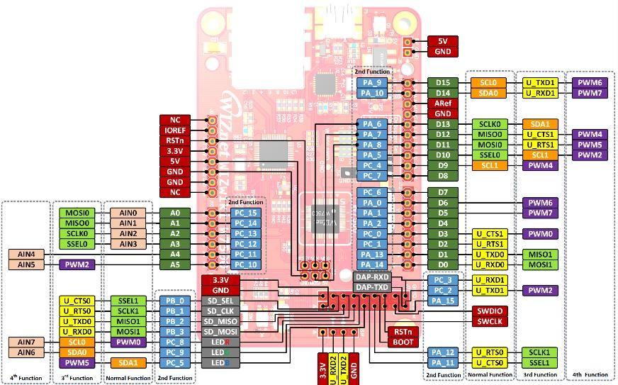
WIZwiki-W7500 Pinout

Slide 12
mbed development environment construction #1
Sign up mbed.org, Install mbed Serial Driver, Register WIZwiki-W7500 platform

Slide 13
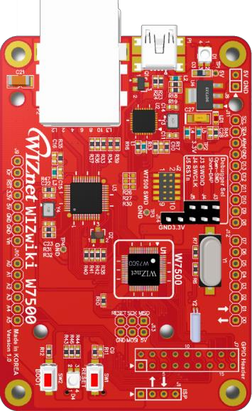
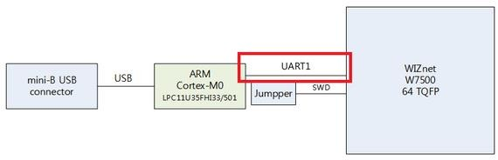
2. Install mbed Serial Driver
1) CMSIS-DAP of WIZwiki-W7500 board provide two functionality.
Download Firmware to target MCU via USB Interface
Transmit UART1 data of W7500 via USB Interface
CMSIS-DAP chip

Slide 14
Adding the target device to ARMmbed account

Slide 15
mbed development environment construction #1
Install Serial Terminal

Slide 16
The first step for IoT episode 1
What is Web Server?!

Slide 17


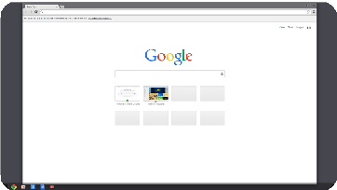






1. Embeded Web Server Overview
HTTP Request
Web Browser
WIZwiki-W7500
HTTP Response

Slide 18
2. HTTP Overview
HTTP is composed Client / Server
HTTP Server : WIZwiki-W7500
HTTP Client : Web Browser
Web Server transmit the required HTML Web page, etc. to Web Browser
Web Browser
(HTTP Client)
WIZwiki-W7500
(HTTP Server)
HTTP GET/POST Request e.g., ‘set_dio.cgi’
HTTP/1.1 200 OK Response(+Return values)

Slide 19
3. HTTP Method
GET
Method to get value of Web Server
Client obtain DATA in Web Server storage
POST
• Method to transmit changed value to Web Server
• When value is changed from Client, Device(Server) receive this request and then change value.

Slide 20
Let’s develop the IoT Device! #1

Slide 21
Control the Digital Sensor with Web page
Digital Sensor (LED) + Web Server (POST)

Slide 22
2. GPIO Theory
1) Digital Input recognize 0volts or 3.3volts Input as ‘0’ or ‘1’ and
Digital Output export digital value of ‘0’ or ‘1’ as 0 volts and 3.3 volts to the outside.
2) 3.3volts is defined as ‘1’, 0volts is defined as ‘0’.
3) Meaning of Digital System
0v | 3.3v
Logic 0 | Logic 1
Open | Close
Off | On
Low | High
Clear | Set
False | True

Slide 23
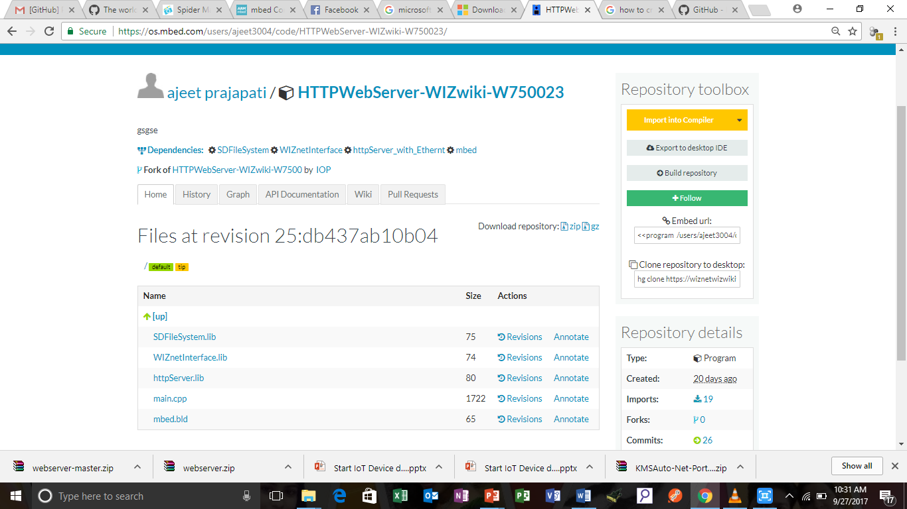
3. 'Control the Digital Sensor with Web page’ practice - mbed Web Compiler
1) HTTP Server Example
https://developer.mbed.org/users/ajeet3004/code/HTTPWebServer-WIZwiki-W750023/
Click to Import

Slide 24
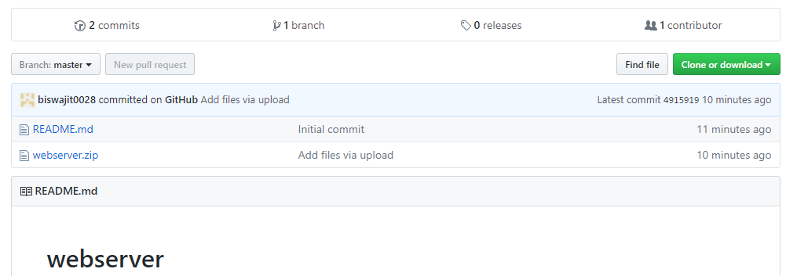
3. 'Control the Digital Sensor with Web page’ practice - mbed Web Compiler
1) HTML web Pages
https://github.com/biswajit0028/webserver
Click to download

Slide 25
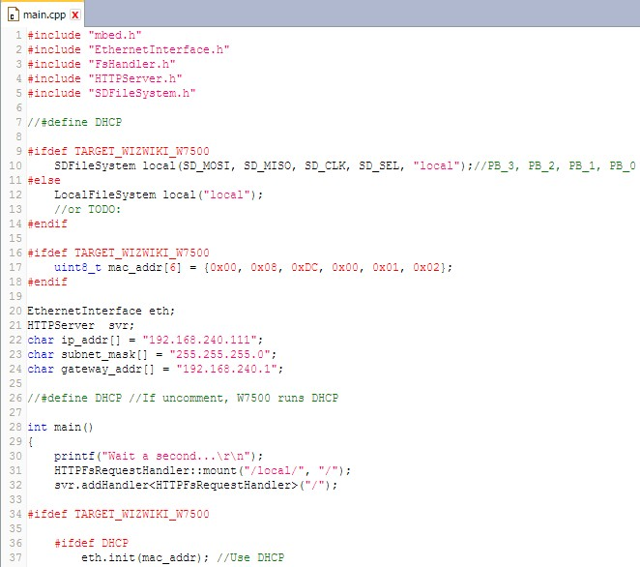
4. 'Control the Digital Sensor with Web page’ practice - mbed Web Compiler
2) IP setting description
Link the library you need using #include
IP address, Subnet mask, Gateway Setting
Can change to values you want

Slide 26
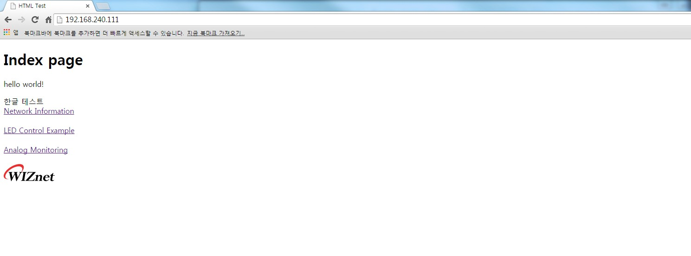
4. 'Control the Digital Sensor with Web page’ practice - mbed Web Compiler
3) Web server operation process description (index.html page)
Call net_info.html
Call dio_page.html
Call ain_page.html
Call wiznet_logo.png

Slide 27
4. 'Control the Digital Sensor with Web page’ practice - mbed Web Compiler
4) Web server operation process description (index.html page)
Call dio_page.html

Slide 28
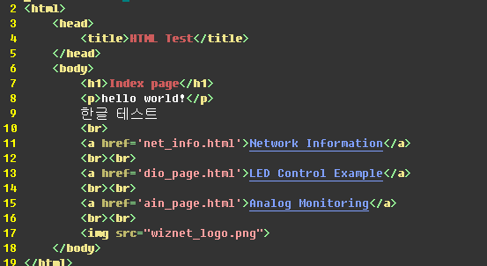
4. 'Control the Digital Sensor with Web page’ practice - mbed Web Compiler
5) Web server operation process description (index.html code)
Call dio_page.html

Slide 29
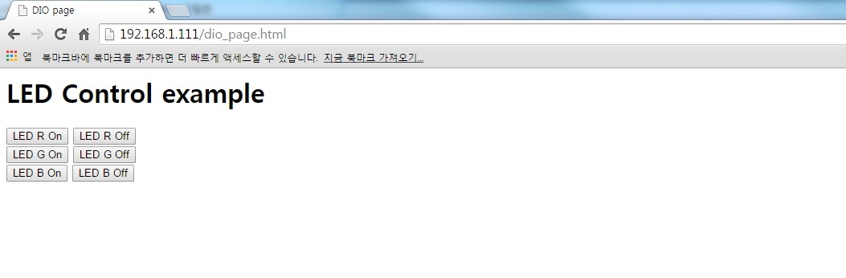
4. 'Control the Digital Sensor with Web page’ practice - mbed Web Compiler
6) Web server operation process description (dio_page.html page)
Call setDiostate(this)

Slide 30
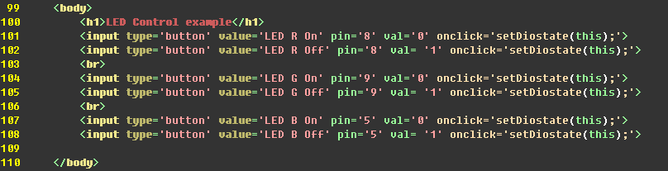
4. 'Control the Digital Sensor with Web page’ practice - mbed Web Compiler
7) Web server operation process description (dio_page.html code)
Call setDiostate(this) as pin = 5 val = 1

Slide 31
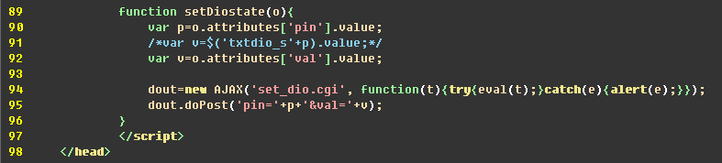
4. 'Control the Digital Sensor with Web page’ practice - mbed Web Compiler
8) Web server operation process description (dio_page.html code)
set_dio.cgi 전송

Slide 32
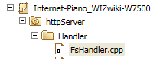
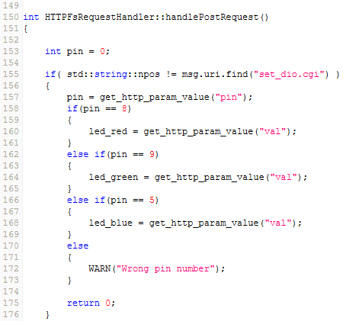
4. 'Control the Digital Sensor with Web page’ practice – mbed Web Compiler
9) Web server operation process description (mbed code : httpServer/Handler/FsHandler.cpp)
If it’s set_dio.cgi, perform the below code
If it’s Pin = 5,
apply value to led_blue

Slide 33
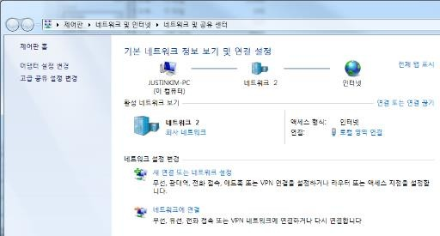
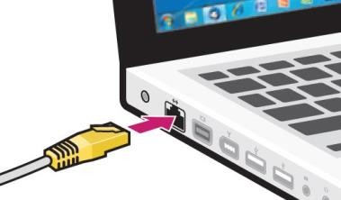
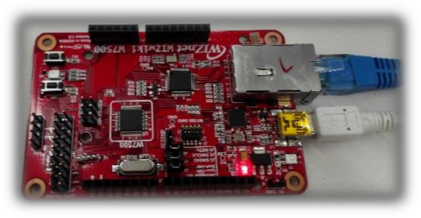
5. IP Setting
1) IP Setting & Ethernet cable connection (PC to WIZwiki-W7500)
Connect PC with
WIZwiki-W7500
using Ethernet cable
Go to ‘Network and Sharing Center’
and Click “Local Area Connection”

Slide 34
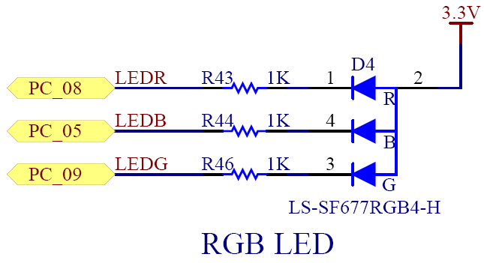
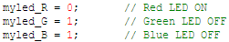
6. W7500 Onboard RBG LED Schematic
1) Digital Out value is ‘0’. But why is LED of W7500 ‘ON’?!
Link URL : WIZwiki-W7500 Technical Reference

Slide 35
Let’s develop the IoT Device! #2

Slide 36
Receive Network Information with Web page
Web Server (GET)

Slide 37
2. ‘Receive Network Information with Web page’ practice - mbed Web Compiler
3) Web server operation process description - (net_info.html page)
Call net_info.html

Slide 38
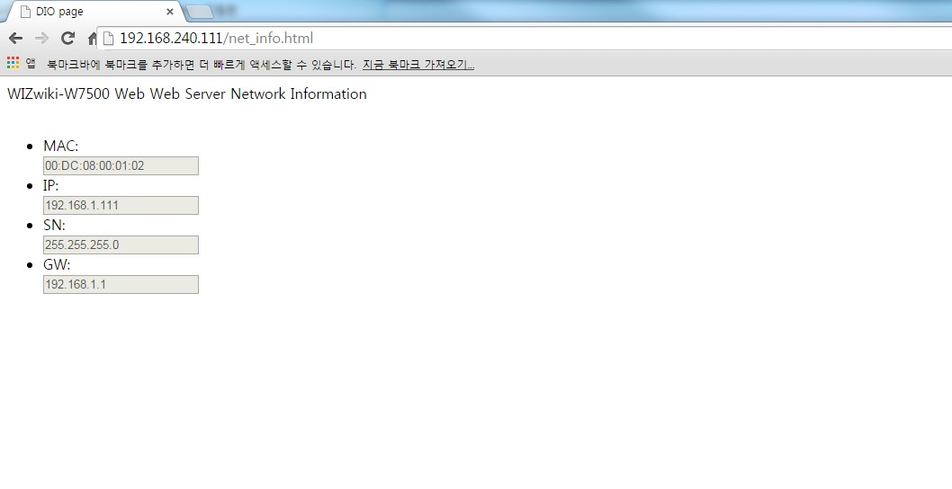
2. ‘Receive Network Information with Web page’ practice - mbed Web Compiler
5) Web server operation process description - (net_info.html page)
When Page is visited, call getNetinfo()

Slide 39
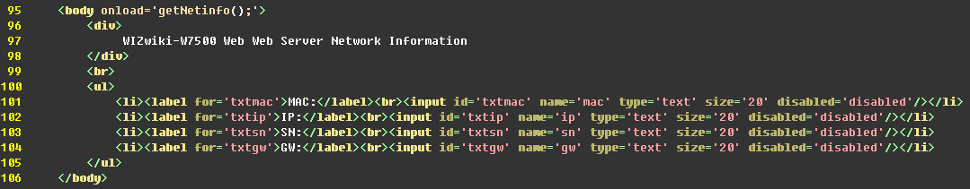
2. ‘Receive Network Information with Web page’ practice - mbed Web Compiler
6) Web server operation process description - (net_info.html code)
When Page is visited, call getNetinfo()

Slide 40
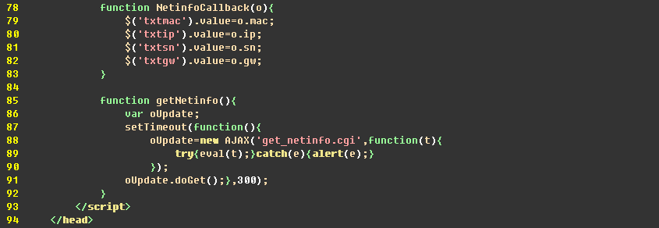
2. ‘Receive Network Information with Web page’ practice - mbed Web Compiler
7) Web server operation process description - (net_info.html code)
Send get_netinfo.cgi

Slide 41
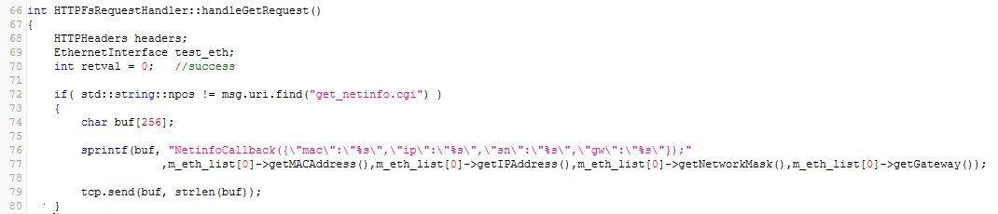
2. ‘Receive Network Information with Web page’ practice - mbed Web Compiler
bed Web Compi
8) Web server operation process description –
(mbed code : httpServer/Handler/FsHandler.cpp)
When it’s get_netinfo.cgi, execute code Execution below
Request NetinfoCallback function with including information of mac, ip, sn, gw a

Slide 42
2. ‘Receive Network Information with Web page’ practice - mbed Web Compiler
9) Web server operation process description - (net_info.html code)
Save the mac value to txtmac

Slide 43
2. ‘Receive Network Information with Web page’ practice - mbed Web Compiler
10) Web server operation process description - (net_info.html code)
Import ‘id = txtgw’ value and then put

Slide 44
Let’s develop the IoT Device! #3

Slide 45
Receive Analog Sensor value with Web page
Analog Sensor (variable resistance, illuminance sensor) + Web Server (GET)

Slide 46
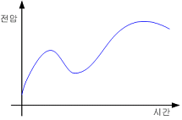
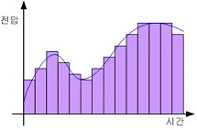
2. ADC Theory
1) Analog Digital Converter(ADC) is convert analog signal to digital signal ‘0’, ‘1’.
2) ADC extract the incoming voltage change sample and then measure the analog signal.
3) It’s used to read various analog sensors value.
voltage
voltage
Time
Time

Slide 47
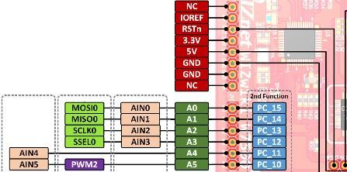
2. ADC Theory - Analog Input Pinout
1) WIZwiki-W7500 extract 0v ~ 3.3v sample as 12bit.
2) Choose either six ADC Pin Out or ADC Channel and use.
ADC Pinout

Slide 48
3. 'Receive Analog Sensor value with Web page’ practice - mbed Web Compiler
3) Web server operation process description - (index.html page)
Call ain_page.html

Slide 49
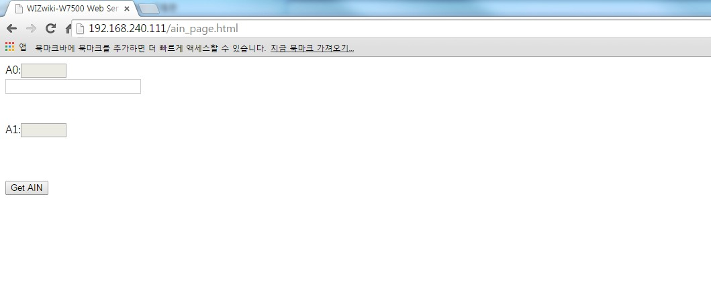
3. 'Receive Analog Sensor value with Web page’ practice - mbed Web Compiler
5) Web server operation process description - (ain_page.html page)
When it’s clicked, call getAin (this)

Slide 50
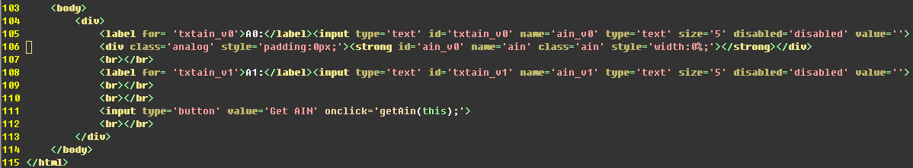
3. 'Receive Analog Sensor value with Web page’ practice - mbed Web Compiler
6) Web server operation process description - (ain_page.html code)
When it’s clicked, call getAin (this)

Slide 51
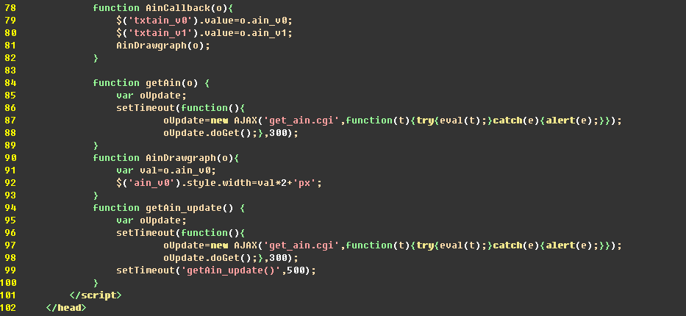
3. 'Receive Analog Sensor value with Web page’ practice - mbed Web Compiler
7) Web server operation process description - (ain_page.html code)
Send get_ain.cgi

Slide 52
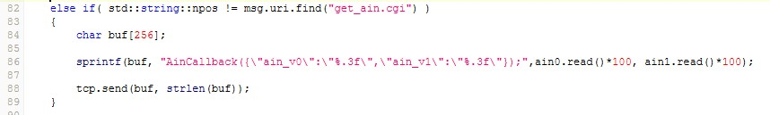
3. 'Receive Analog Sensor value with Web page’ practice - mbed Web Compiler
8) Web server operation process description –
(mbed code : httpServer/Handler/FsHandler.cpp)
If it’s get_ain.cgi, execute code below
Request function AinfoCallback with including ain_v0, ain_v1

Slide 53
3. 'Receive Analog Sensor value with Web page’ practice - mbed Web Compiler
9) Web server operation process description - (ain_page.html code)
Save ain_v1 value to txtain_v1
Call AinDrawgraph(o) function

Slide 54
3. 'Receive Analog Sensor value with Web page’ practice - mbed Web Compiler
10) Web server operation process description - (ain_page.html code)
Save ain_v0 value to Val and print graph style using the value

Slide 55
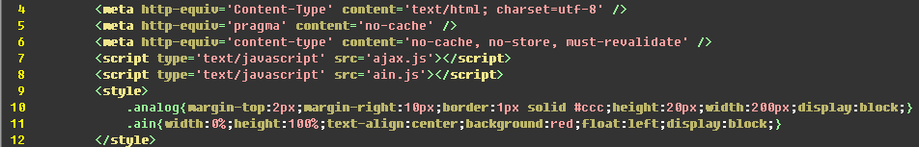
3. 'Receive Analog Sensor value with Web page’ practice - mbed Web Compiler
11) Web server operation process description - (ain_page.html code)
Graph style definition part

Slide 56
3. 'Receive Analog Sensor value with Web page’ practice - mbed Web Compiler
12) Web server operation process description - (ain_page.html code)
Print out ain_v0 value of graph draw part to graph
Import id = txtain_v1 value and then put

Slide 57
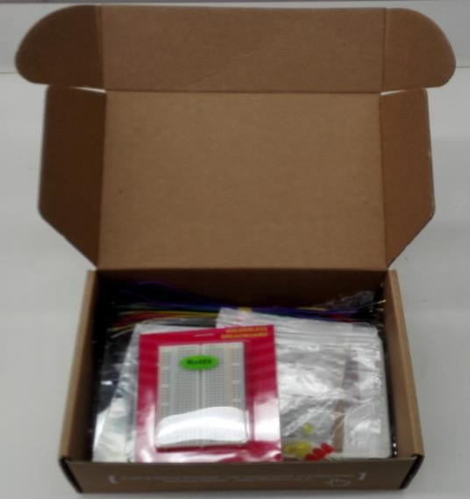
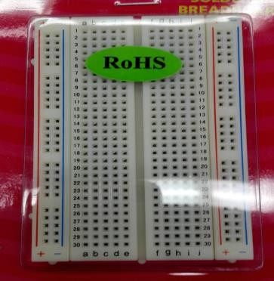
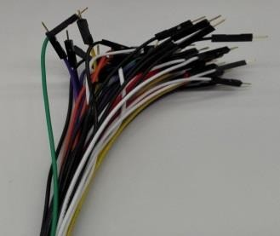



4. H/W implementation - W7500 Starter Kit
1) Use WIZwiki-W7500 Starter Kit
GF063PK B103
PGM5537D

Slide 58



4. H/W implementation - W7500 Starter Kit
2) Breadboard Layout
3.3v:VCC
VCC
3.3V
GND
WIPER
3.3V
1.6V
A0:WIPER
A1:V_out
GND
GND
3.3v
GND
VCC
V_out
GND
A0
A1
GND:GND

Slide 59



4. H/W implementation - temperature sensor
3) Use WIZwiki-W7500 Starter Kit
LDR

Slide 60

4. H/W implementation - temperature sensor
4) Breadboard Layout using WIZwiki-W7500 Starter Kit
A1

Slide 61
QnA Thank you

